Slide 1
The Magic of Docker and Microservices
Nitin Vashisth
Smith Agarwal

Slide 2
Problem with regular deployment of application ? 1. OS Dependent 2. Not Scalable 3. Not Portable 4. Lot more …
Notes:
OS Dependent • Different deployment procedure and requirements for different OS.
Not-Scalable • Create more VMs ?
Not-Portable • Running the same procedure from starting again on the new machine ?

Slide 3
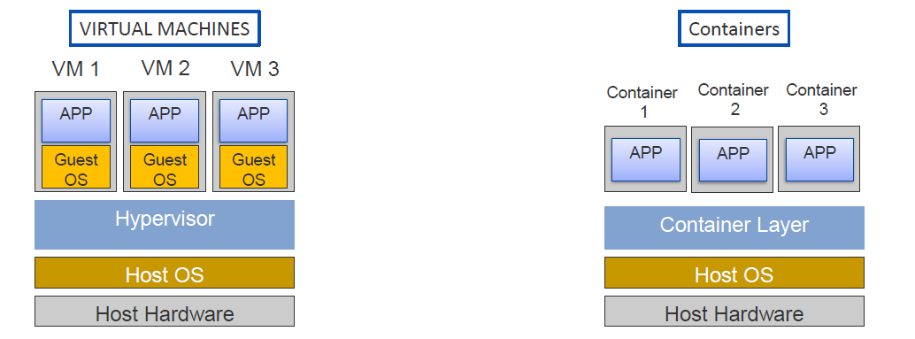
Containerization
Notes:
What?
• is an OS-level virtualization method for deploying and running distributed applications without launching an entire VM for each application.
• share the same OS kernel as the host.

Slide 4
How this containerization can be achieved?

Slide 5
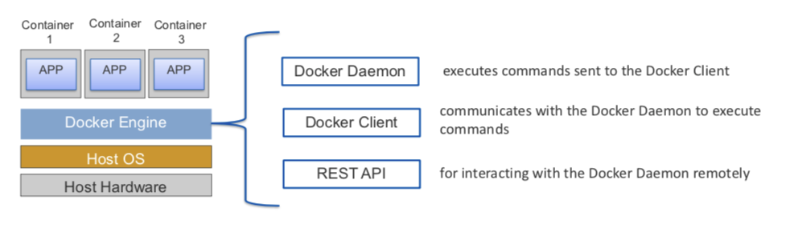
Docker
Notes:
Docker is a tool that packages, provisions and runs containers independent of the OS.

Slide 6
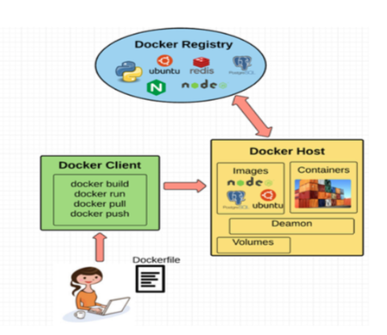
Docker
Notes:
Docker is a tool that packages, provisions and runs containers independent of the OS.

Slide 7
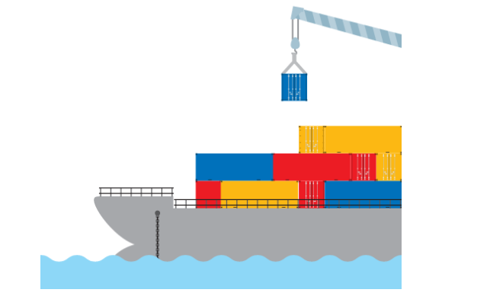
Why Containers?
In real world, if a country wants to export any luggage to another country, they put them into a container then they ship that container either by road or through a dock to another country

Slide 8
Containers
The same applies to Docker for running and maintaining distributed applications.
It packs your application in a container with all of your application's bins\libs and dependencies
makes it fully isolated from external environments regardless of where it is running
we can ship that container to any where i.e. To any other OS, to Docker Registry (such as Docker Hub) or to the cloud
OS Independent
Scalable
Portable

Slide 9
Docker Hub
Cloud-based registry service
Allows you to link to code repositories, build your images, stores manually pushed images, and links to Docker Cloud so you can deploy images to your hosts
It provides a centralized resource for container image discovery, distribution and management

Slide 10
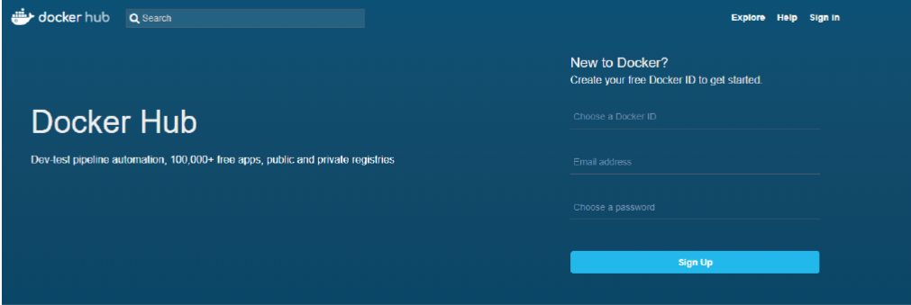
Docker Hub
Notes:
•Cloud-based registry service
•Allows you to link to code repositories, build your images, stores manually pushed images, and links to Docker Cloud so you can deploy images to your hosts.
•It provides a centralized resource for container image discovery, distribution and management

Slide 11
Docker Hands-on Demo https://github.com/nvnvashisth/Docker-Workshop/blob/master/README.md

Slide 12
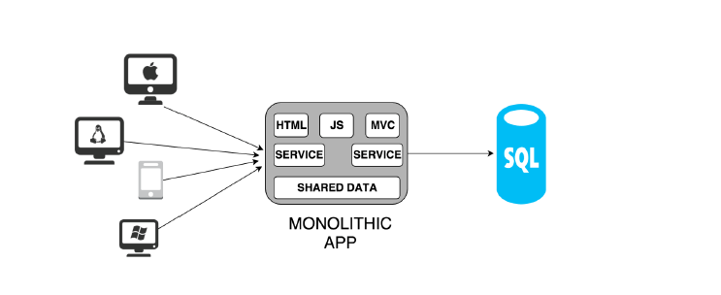
Monolithic Architecture
Notes:
When we develop a server-side application, we start with a layered application which usually have following components:
A database (which consist of many tables usually in a relational database management system).
A client-side user interface (consisting of HTML pages and/or JavaScript running in a browser)
A server-side application.
But despite having the layered architecture the application is packaged into a single monolith (a massive structure) type architecture and deployed on the cloud. The deployed structure will look like as shown in below figure.

Slide 13
Disadvantage
Too large and Complex
Limitation in size and complexity
Slow start time
Re-deployment of complete application on update
Difficult in scaling
Reliability
Notes:
Limitation in size and complexity: This approach has limitation in size and the complexity. There cannot be simply just continuous addition to previous code.
Too large and complex: Newly joining developers have to understand the complete application. But the application is too large and complex to fully understand and make changes fast and correctly.
Slow start time: The application start time is directly dependent on the size of the application. If the application size grows the start time of the application also increasers.
Re-Deployment of the Application on Updates: If there were any updates, then the entire application must be re-deployed which increases the application downtime.
Difficult in Scaling: Scaling monolithic applications can also be difficult when different modules have conflicting resource requirements.
Reliability: Bug in any module (e.g. memory leak) can potentially bring down the entire process. Moreover, since all instances of the application are identical, that bug will impact the availability of the entire application.
Barrier to adopting new technologies: Since changes in frameworks or languages will affect an entire application it is extremely expensive in both time and cost.

Slide 14
How can we solve these problems?

Slide 15
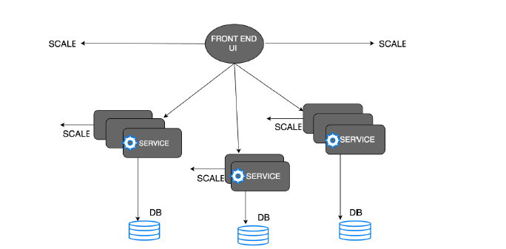
Microservice Architecture
Notes:
To avoid the monolithic architecture drawbacks, the idea here is to split the application into a set of smaller, interconnected services. Each service intercommunicates with a common communication protocol like REST web service with JSON. Each service run individually either in single machine or different machine, but they execute its own separate process. Each service may have own database or storage system, or they can share common database or storage system. Microservice is all about distribute or break application in small chunks. The deployed microservice architecture structure will look like as shown in below figure.

Slide 16
Benefits of Microservices Architecture
Easier to understand and maintain
Independence of Service
No Barrier on Adopting New Technologies
Independent Service Deployment
Easy Scaling
Notes:
Data scientists often spend 50% or more of the time building a machine-learning model getting the data ready for training by filtering out columns that aren't relevant to the analysis (or that would bias the results), removing rows with missing data or algorithmically filling in missing data, removing duplicate rows from the dataset, etc. ML Studio includes several modules for performing such tasks. It even includes modules for helping select the columns or "features" that have the greatest statistical influence on the outcome.

Slide 17
Demo
https://github.com/nvnvashisth/Docker-Workshop/blob/master/README.md
Notes:
Work Exercise 2 of the challenge and invite students to follow along with you.

Slide 18
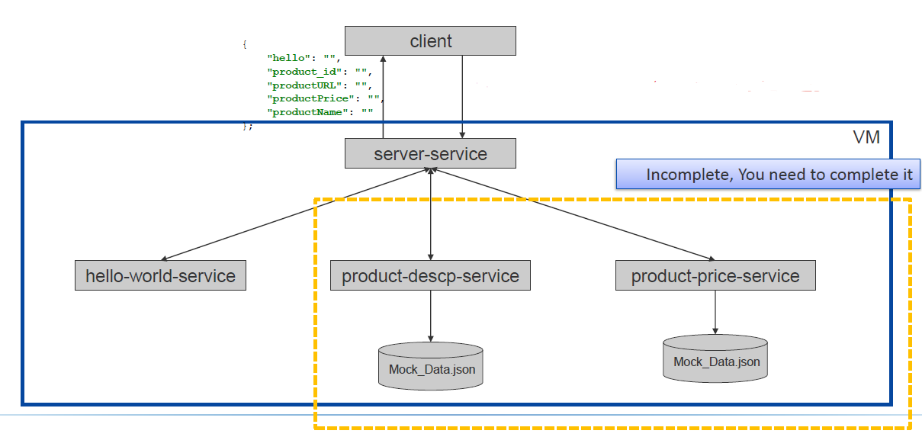
Big overview of our exercise

Slide 19
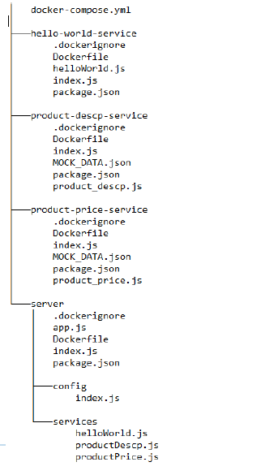
← Directory structure

Slide 20
Implement now !
Complete the microservice product description service (to get product name and URL) and product price service (to get the product price)
2. Files which need to be completed
product-price-service/product_price.js
server/services/product_price.js
product-descp-service/product_descp.js
server/services/product_descp.js
docker-compose.yml(addyourdockerhubid)
https://github.com/nvnvashisth/Docker-Workshop/blob/master/README.md

